Slide 2
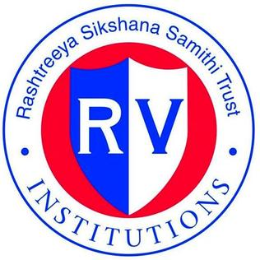
LITERATURE SURVEY- IEEE CONFERENCES
RESEARCH GAP
Conventional farming- Manual work leads to water wastages.
The already existing automated farming solutions are not cost effective.
There are no database of the weather and climatic conditions and the corresponding type and yield of crops are absent.

